Slide 1
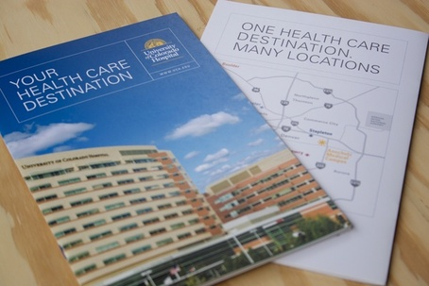
Lyneath ID your universal health identity
Riya Saxena
2nd year , Internet of things , MITS Gwalior
| 2026 IEEE hackmatrix
This Photo by Unknown Author is licensed under CC BY-SA-NC

Slide 2
Problem Statement : healthcare
The Healthcare Data
Patient medical records are fragmented across hospitals, labs, and clinics.
Patients carry physical reports that can be lost or damaged.
Doctors lack complete medical history during emergencies.
Patients repeat costly tests due to unavailable previous reports.
Rural and elderly populations face difficulty managing health records.
Impact:
Delayed diagnosis
Increased healthcare costs
Poor continuity of care

Slide 3
Solution: LyneAth ID A universal QR-based healthcare identity that allows every citizen to securely access and share medical records. Every citizen gets a secure QR-based health identity connected to their medical profile. The patient controls: who accesses their data what information is shared how long access is provided

Slide 4
Working Of LYNEATH ID
Patient Registration
Create Lyneth ID profile
Add basic health information
↓
Upload Medical Records
Reports
Prescriptions
Previous history
↓
Generate QR Health Identity
↓
Secure Medical Access
Doctor scans QR
Patient approves access
Medical information is displayed

Slide 5
Emergency use case
Scenario: Accident Emergency
Without Lyneath ID ❌
Ramesh, a 55-year-old patient, meets with an accident
Doctors do not know:
Existing diseases
Allergies
Current medicines
Previous surgeries
Treatment decisions are delayed.
With Lyneath ID
Hospital staff finds Lyneth QR card.
Doctor scans QR using verified healthcare application and sees the history with AI summary involved
Emergency access is provided.
Doctor receives critical information.

Slide 6
Emergency Profile: generated
Name: Ramesh Kumar
Age: 55
Blood Group: B+
Allergy: Penicillin
Condition: Type-2 Diabetes
Current Medicine: Insulin
Previous Surgery: Heart Stent
Key Features
Lyneth ID Features
🔹 QR-Based Health Identity
One identity connected to medical records.
🔹 Patient Data Ownership
Patients control their health information.
🔹 Emergency Access Mode
Critical details available during emergencies.
🔹 Medical Report Storage
Secure storage of reports and prescriptions.
🔹 AI Health Summary (Future Enhancement)
Converts multiple reports into a simple doctor-friendly summary in multi language

Slide 7
Secure Healthcare Data Sharing
Lyneth ID does not store medical information inside the QR code.
Security Approach:
Encrypted medical data storage
Verified healthcare provider login
Consent-based access
Access history tracking
Important:
Healthcare staff do not open the patient's phone.
They use: Verified Lyneth Healthcare Application → QR Scan → Authorized Access
Minimum Viable Product (MVP)
Patient Portal:
Create health profile Upload sample reports Generate QR identity
Doctor Portal:
Login verification Scan patient QR View authorized medical information
Emergency Module:
Blood group Allergies Critical conditions

Slide 8
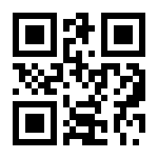
Impact & Conclusion
Making Healthcare Records Accessible for Everyone
Expected Impact:
✅ Faster emergency treatment ✅ Reduced duplicate medical tests ✅ Better doctor decision-making ✅ Improved rural healthcare access Just like UPI simplified digital payments, Lyneath ID can simplify access to healthcare information for every Indian citizen.

